Slide 1
Module – 15 Managing the Storage Infrastructure
Notes:
Module – 15
Managing the Storage Infrastructure

Slide 2
Module 15: Managing the Storage Infrastructure
Upon completion of this module, you should be able to:
List the key storage infrastructure components that are monitored
List the key monitoring parameters
Describe the storage management activities
Describe the storage infrastructure management challenges and their solutions
Describe the information lifecycle management (ILM) strategy

Slide 3
Module 15: Managing the Storage Infrastructure
Lesson 1: Monitoring the Storage Infrastructure
During this lesson the following topics are covered:
Key storage infrastructure components that are monitored
Monitoring parameters
Types of alerts

Slide 4
Storage Infrastructure Management
Managing storage infrastructure is key to ensure continuity of business
Establishing management processes and implementing appropriate tools are essential to meet service levels
Virtualization have changed the storage infrastructure management paradigm
Monitoring is the most important aspect that forms the basis for storage management

Slide 5
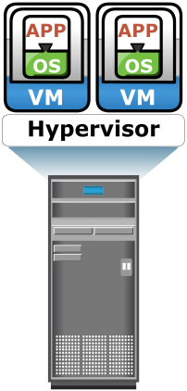



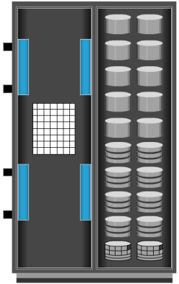
Monitoring Storage Infrastructure
Clustered Server
Redundant Arrays
Client
Redundant HBAs
Redundant FC Switches
NIC
HBA
NIC
HBA
IP
Redundant Network
Production Storage Arrays
Remote Storage Arrays
NIC
HBA
NIC Teaming
NIC
HBA
Accessibility
Key components that should be monitored are:
Servers
Networks
Storage arrays
Capacity
Performance
Security
Parameters Monitored

Slide 6
Monitoring Parameters
Accessibility
To identify failure of any component that may lead to service unavailability or degraded performance
Capacity
To ensure availability of adequate amount of resources and prevent service unavailability or degraded performance
Performance
To evaluate efficiency and utilization of components and identify bottlenecks
Security
To ensure confidentiality, integrity, and availability of storage infrastructure

Slide 7
Components Monitored – Host
Accessibility
Hardware components such as HBAs, NICs, and internal disks
Status of various processes/applications
Capacity
File system utilization
Database: table space/log space utilization
User quota
Performance
CPU and memory utilization
Transaction response time
Security
Authentication and authorization
Physical security (data center access)

Slide 8
Components Monitored – Network
Accessibility
Physical components such as switches and ports
Logical components such as zones
Capacity
Interswitch links and port utilization
Performance
Assess individual component performance and help to identify network bottlenecks
Monitoring port performance and link utilization
Security
Unauthorized changes to the fabric
Login failures

Slide 9
Components Monitored – Storage
Accessibility
Hardware components such as controllers and disks
Software processes such as replication processes
Capacity
Capacity utilization and consumption trend
Performance
Utilization rates of storage array components
I/O response time, cache utilization
Security
Access control and physical security (data center access)

Slide 10
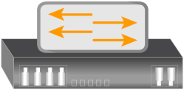
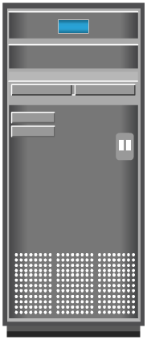
Accessibility Monitoring Example: Switch Failure
No redundancy due to switch SW1 failure
H1
SW 1
Application
Servers
H2
SW 2
Storage Array
H3
→ Inaccessible

Slide 11
Capacity Monitoring Example: File System Space
FS Extended
Critical: FS is 80% Full
Warning: FS is 66% Full
Server
File System
Server
File System
Without File System Monitoring
With File System Monitoring
→ Inaccessible

Slide 12
Performance Monitoring Example: Array Port Utilization
H1
SW 1
Port
Application
Servers
H2
Port
SW 2
Storage Array
H3
100%
Port Utilization %
New Server
H1 + H2 + H3

Slide 13

Security Monitoring Example: Storage Array
SW 1
WG2
Workgroup 2 (WG2)
WG1
SW 2
Replication Command
Storage Array
Warning: Attempted replication of WG2 devices by WG1 user – Access denied
→ Inaccessible
Workgroup 1 (WG1)

Slide 14
Alerts
It is an integral part of monitoring
It keeps administrators informed on the status of components and processes
Monitoring tools enable administrators to assign different severity levels for different events
Classified as information, warning, and fatal alerts
Type of alerts | Description | Example
Information | Provide useful information Does not require administrator intervention | Creation of zone or LUN
Warning | Require administrative attention | FS becoming full Soft media errors
Fatal | Require immediate attention | Component failure Power failure

Slide 15
Module 15: Managing the Storage Infrastructure
Lesson 2: Managing the Storage Infrastructure
During this lesson the following topics are covered:
Storage infrastructure management activities
Storage infrastructure management in virtualized environment
Storage infrastructure management challenges
Ideal solution for storage infrastructure management

Slide 16
Storage Infrastructure Management Activities
Redundant Arrays
Client
Redundant HBAs
Redundant FC Switches
NIC
HBA
NIC
HBA
IP
Redundant Network
Production Storage Arrays
Remote Storage Arrays
NIC
HBA
NIC Teaming
NIC
HBA
Clustered Server
Accessibility
Key components that should be managed are:
Servers
Networks
Storage arrays
Capacity
Reporting
Performance
Security
Management Activities

Slide 17
Availability Management
Availability Management
The goal of availability management is to ensure that the availability requirements of all the components and services are constantly met.
Key activity is to provision redundancy at all levels
Example of availability management tasks are:
Installing two or more HBAs per server
Installing multipathing software
Deploying clustered server
Configuring RAID
Deploying redundant fabric
Configuring data backup and replication

Slide 18
Capacity Management
Capacity Management
The goal of capacity management is to ensure adequate availability of resources, based on their service level requirements.
Example of capacity management activities are:
Storage provisioning
Enforcing capacity quota for users
Capacity consumption trend analysis
Technologies such as data deduplication, compression, and virtual provisioning help to manage storage capacity efficiently

Slide 19
Performance Management
Performance Management
The goal of performance management is to ensure the optimal operational efficiency of all components.
Key activities are:
Fine tuning for performance enhancement
Identifying performance bottlenecks
Example of performance management activities are:
Configuring multiple paths
Choosing appropriate RAID type and cache configuration

Slide 20
Security Management
Security Management
The goal of security management is to ensure confidentiality, integrity, and availability of information.
It prevents unauthorized access and configuration of storage infrastructure components
Examples of security management tasks are:
Managing user accounts
Configuring zoning and LUN masking
Configuring encryption services
Installing antivirus and firewalls
Auditing of event logs

Slide 21
Reporting
Involves gathering information from various components or processes and generating reports
Commonly used reports are:
Capacity planning report
Configuration and asset management reports
Performance report
Chargeback report

Slide 22
Storage Infrastructure Management in Virtualized Environment
Virtualization technology has enabled managing storage infrastructure efficiently
Virtualization at storage layer
Example: virtual provisioning of LUN
Virtualization at network layer
Example: VLAN and VSAN
Virtualization at compute layer
Example: Virtual machines, memory virtualization

Slide 23
Storage Multitenancy
Enables multiple tenants to share the same storage resources provided by a single landlord (resource provider)
Security and service level assurance are key concerns in a multitenant storage environment
Secure storage multitenant environment should follow the four pillars of multitenancy
Secure separation
Service assurance
Availability
Management

Slide 24


Storage Management Example 1 – Storage Allocation to a New Server
Server
SAN
Storage Array
Allocate Volumes
to the Server
File/
File
Volume
Assign LUNs to the Ports
Create LUNs
Database
System
Management
Management
Management
Zoning
1
2
1
2
1
3
3
Database
Configured
File
System
Configured
Volume
Group
Created
Allocated
to the Server
HBAs
Front-End Ports
Assigned to
Storage Ports
Configured
Storage
Unconfigured
Storage
Storage Allocation Tasks

Slide 25
Storage Management Example 2 – Chargeback Report
Engineering_1 Server
SW 1
Payroll_1 Server
Source Vol 1
Source Vol 2
Remote Replica Vol 1
Remote Replica Vol 2
VG
LV
FS
VG
A
C
DB App
LV
FS
DB App
Local Replica Vol 1
Local Replica Vol 2
Unallocated
Unallocated
SW 2
B
Application Servers
Production Storage Arrays
Remote Storage Arrays
Application | Storage (GB) | Production Storage Raw (GB) | Local Replica Storage Raw (GB) | Remote Replica Storage Raw (GB) | Total Storage RAW (GB) | Chargeback Cost $5/Raw (GB)
Payroll_1 | 100 | 200 | 100 | 125 | 425 | 2125
Engineering_1 | 200 | 250 | 200 | 250 | 700 | 3500

Slide 26
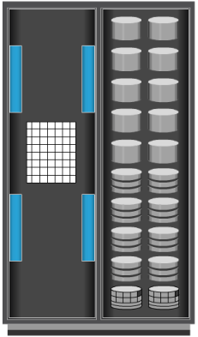

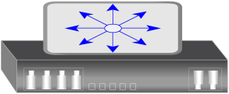
Storage Infrastructure Management Challenges
Hitachi
Storage Arrays
EMC
HP
CAS
NAS
DAS
IBM
SAN
TLU
NetApp
SUN
Servers
Network
UNIX
MF
Cisco
WIN
FC
IP
Databases
Applications
Brocade
Oracle
Informix
MS SQL

Slide 27
Developing an Ideal Solution
One UI
Monitoring/Management Platform
Storage Arrays
Network
Servers, Databases, Applications
Storage Arrays
CAS
NAS
DAS
SAN
TLU
Servers
Network
UNIX
MF
WIN
FC
IP
Databases
Applications

Slide 28
Storage Management Initiative (SMI)
SNIA has been engaged in an initiative to develop a common storage management interface
SNIA developed a specification called Storage Management Initiative-Specification (SMI-S)
It forms a normalized, abstracted model to which a storage infrastructure components can be mapped
Enables standardized and end-to-end control of resources
SMI-S compliant products are easier and faster to deploy
Eliminates the need for development of vendor-proprietary management interfaces

Slide 29
Enterprise Management Platform
Suite of applications for managing and monitoring storage infrastructure
Provides end-to-end management of physical and virtual resources
Generates alerts to inform the status of components and processes
Schedules operations such as provisioning and configuration management

Slide 30
Module 15: Managing the Storage Infrastructure
Lesson 3: Information Lifecycle Management
During this lesson the following topics are covered:
Challenges of managing information
Information lifecycle management
Storage tiering

Slide 31
Challenges in Managing Information
Exploding digital universe
Multifold increase of information
Increasing dependency on information
Strategic use of information plays an important role in determining the success of a business
Changing value of information
Information that is valuable today may become less important in future

Slide 32
Information Lifecycle Management
New
Process
Deliver
Warranty
order
order
order
claim
Time
Value of
Information
Fulfilled
Aged
Warranty
order
data
Voided
Create
Access
Migrate
Archive
Dispose
A proactive strategy that enables an IT organization
to effectively manage the information throughout its lifecycle

Slide 33
Benefits of ILM
Provides lower total cost of ownership
By aligning the infrastructure and management costs with changing value of information
Provides simplified management
By automating the processes
Maintains compliance
Knowledge of what data needs to be protected for what length of time
Optimized utilization
By deploying storage tiering

Slide 34
Storage Tiering
Storage Tiering
It is a technique of establishing a hierarchy of storage types and identifying the candidate data to relocate to the appropriate storage type to meet service level requirements at a minimal cost.
Each tier has different levels of protection, performance, and cost
Efficient storage tiering requires defining tiering policies
Storage tiering implementations are:
Manual storage tiering
Automated storage tiering
Data movement occurs between tiers
Within a storage array (Intra-array)
Between storage arrays (Inter-array)

Slide 35
Intra-array Storage Tiering
LUN tiering
Moves entire LUN from one tier to another
Does not give effective cost and performance benefits
Sub-LUN tiering
A LUN is broken down into smaller segments and tiered at that level
Provides effective cost and performance benefits
Tier 0
LUN
LUN
Move entire LUN
with active data
from tier 1 to tier
0 for improved
performance
Move entire LUN
with inactive
data from
tier 0 to tier 1
Tier 1
LUN
LUN
LUN Tiering
Tier 0
Move active data from tier 1 to tier 0 for improved performance
Move inactive data from tier 0 to tier 1
Tier 1
Sub-LUN Tiering
Inactive Data
Active Data

Slide 36

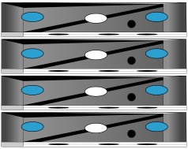
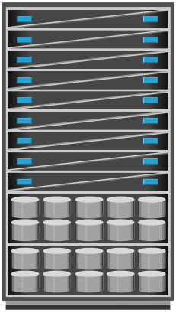
Inter-array Storage Tiering
Facilitates policy-based data movements between tiers
Storage
Network
Policy Engine
Application Servers
Tier 1
Primary Storage
Tier 2
Secondary Storage

Slide 37
Cache Tiering
Enables creation of a large capacity secondary cache using SSDs
Enables tiering between DRAM cache and SSDs (secondary cache)
Most reads are served directly from high performance tiered cache
DRAM Cache
Tier 0
SSD
Tier 1
Tired Cache
Storage Array
Benefits
Enhances performance during peak workload
Non-disruptive and transparent to applications

Slide 38
Module 15: Managing the Storage Infrastructure
Concept in Practice
EMC ControlCenter
EMC Prosphere
EMC Unisphere
EMC Unified Infrastructure Management (UIM)

Slide 39
EMC ControlCenter
An enterprise management platform
Contains storage resource management applications to manage a multi-vendor storage infrastructure
Provides an end-to-end view of the entire networked storage infrastructure including virtualized environment
Enables implementation of ILM strategy by providing management of tiered storage infrastructure
Has built-in security features that provide access control, data confidentiality, data integrity, logging, and auditing

Slide 40
EMC Prosphere
It is a storage resource management software, built to meet the demands of the new cloud computing era
Following are the key capabilities:
Provides end-to-end visibility of all objects
Enables multi-site management from a single console
Improves productivity in virtualized environments with “Smart Groups”
Enables fast, easy, and efficient deployment
Agent-less discovery of objects
Prosphere is packaged as virtual appliance

Slide 41
EMC Unisphere
It is a unified storage management platform for managing:
EMC VNX and VNXe
EMC RecoverPoint/SE
Some of the key capabilities offered by Unisphere are:
Provides unified management for file-based, block-based, and object-based storage
Supports automated storage tiering
Provides management of both physical and virtual components

Slide 42
EMC Unified Infrastructure Manager (UIM)
Unified management solution for Vblocks
Enables configuring Vblock resources and activating services
Provides a dashboard showing Vblock infrastructure configuration and resource utilization
Provides a topology view of Vblock infrastructure
Provides an alerts console that lists alerts against adversely affected resources and services
Performs compliance check during resource configuration

Slide 43
Module 15: Summary
Key points covered in this module:
Key storage infrastructure components that are monitored
Key monitoring parameters
Storage management activities
Storage infrastructure management challenges
Enterprise management platform
Information lifecycle management
Storage tiering

Slide 44
Course Summary
Key points covered in this course:
Key elements of data center environment
Key components of intelligent storage systems and RAID technology
Storage networking technologies
Business continuity solutions
Cloud computing technology
Security and management of storage infrastructure

Slide 45
Module 15: Managing the Storage Infrastructure
45

